Slide 1




Department of Software Engineering Capstone Project Phase A Braude College of Engineering, Israel Project number: 24-2-R-2
Analyzing article's citations -
by using anomaly detection in
dynamic graphs via transformer
Presenters:
Elroei Seadia: 315093419
Dvir Bublil: 315731570
Supervisor - Prof. Zeev Volkovich

Slide 2

Introduction
A citation is a reference to a source of information used in a piece of research or academic work.
Types of Citations:
In-text Citations: Brief references within the body of the text.
Bibliography/References: A complete list of sources at the end of a document.
Benefits:
Tracing the Evolution of Ideas.
Measuring reserch Impact.

Slide 3

Why Accurate Citations Matter in Research
Credit and Recognition: Accurate citations give proper credit to original authors and researchers, fostering academic integrity.
Research Traceability: Citations create a clear path for researchers to follow the development of ideas and build upon previous research.
Quality Assessment: Citation analysis helps evaluate the impact and significance of research, aiding in identifying influential works.
Research Reproducibility: Detailed citations enable other researchers to replicate experiments and verify findings, enhancing scientific rigor.

Slide 4

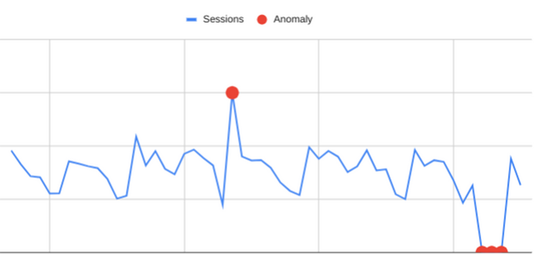

Anomaly detection
Definition:
A technique used to identify patterns or data points that significantly differ from the majority of the data. These unusual patterns may indicate significant, often hidden, phenomena or errors.
Purpose:
To uncover outliers or deviations from expected behavior which could signal issues like fraudulent activities, system malfunctions, or significant changes in data trends.
Techniques for Detection:
Statistical Methods - Utilize statistical properties of data to identify anomalies
Deep Learning - Earn from data and detect anomalies based on learned patterns.
Machine Learning - Using neural networks to identify complex anomalies.

Slide 5


Challenges in Citation Anomaly Detection
Static Graph Assumption: Many methods treat citation networks as static structures, neglecting the temporal evolution of citation patterns.
Scalability Issues: Handling large-scale citation networks can be computationally expensive for some approaches.
Lack of Contextual Understanding: Existing methods often overlook the contextual information surrounding citations, limiting the accuracy of anomaly detection.
Limited Temporal Analysis: Most existing methods fall short in tracking the evolution of research trends and identifying emerging patterns over time.

Slide 6


About our Approach
We leverage the TADDY framework to identify anomalous citation patterns by transforming citation networks into dynamic graphs. Our goal is to gain deeper insights into research trends and to detect potential misconduct or human errors. By doing so, we can trace the development and evolution of research more effectively.

Slide 7

Why using TADDY
Dynamic Graph Representation: TADDY effectively captures the evolving nature of citation networks, allowing for the detection of time-dependent anomalies.
Contextual Understanding: By considering local neighborhoods around edges, TADDY gains a deeper understanding of citation relationships.
Transformer-Based Learning: TADDY's transformer architecture excels at capturing complex patterns and dependencies within citation networks.
Temporal Tracking: TADDY enables the tracking of articles and their evolution over time through the analysis of citation patterns.

Slide 8
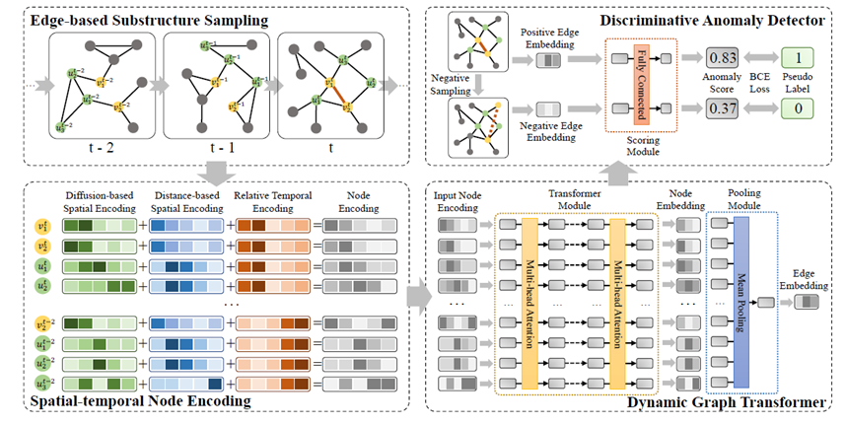
TADDY Architecture
TADDY is a framework for detecting anomalies in dynamic graphs. It captures node characteristics and temporal patterns using a novel encoding strategy and a transformer-based model.

Slide 9
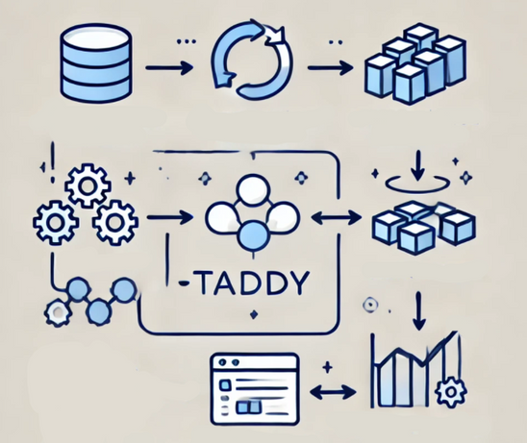
The Research Process
Data Collection: Gather comprehensive citation dataset.
Data Preprocessing: Extract citation relationships, create graph structure.
Dynamic Graph Construction: Create snapshots of the network over time (creating dynmaic graph).
Edge-Based Substructure Sampling: Extract local neighborhoods around target edges.
Spatial-Temporal Node Encoding: Convert node features into vectors capturing spatial and temporal information.
Dynamic Graph Transformer: Process encoded nodes to learn complex patterns.
Anomaly Detection: Assign anomaly scores to citations based on learned patterns.

Slide 10
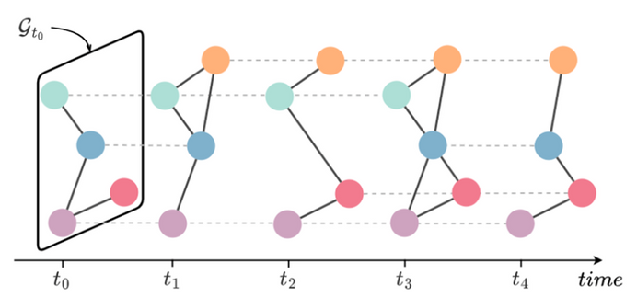
Snapshots and Timestamps
Captures Dynamic Nature: Snapshots capture the evolving state of the citation network over time.
Enables Temporal Analysis: Timestamps provide a precise timeline for tracking citation patterns and identifying anomalies.
Supports Anomaly Detection: Time-based analysis helps distinguish between normal and anomalous citation behaviors.
Enhances Interpretability: Timestamps provide context for understanding the reasons behind detected anomalies.
Clear Article Representation: Creates a clear picture of article evolution and trajectory over time, enabling in-depth analysis.

Slide 11
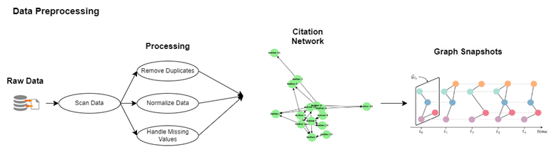
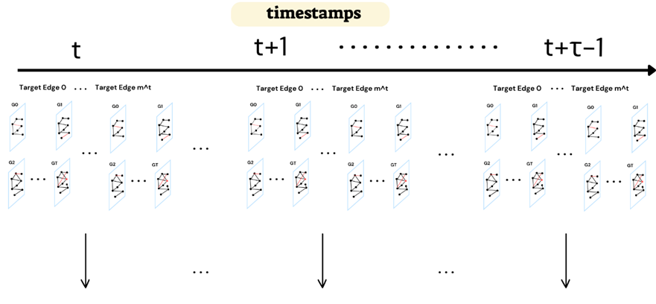

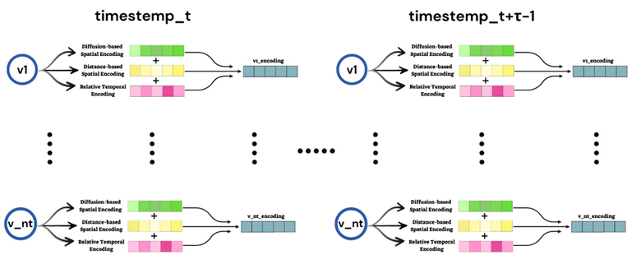
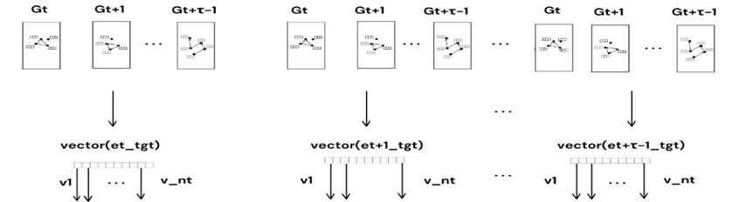
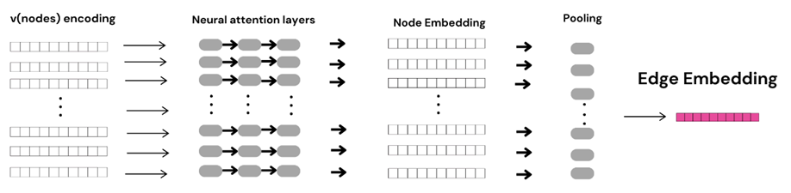
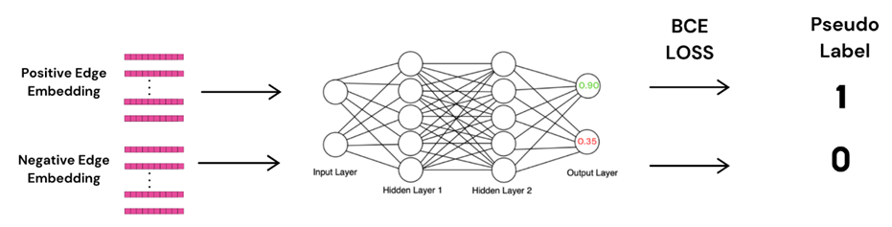
Visualization of the process

Slide 12
Expected Challenges
Acquiring the Right Dataset:
Finding a dataset that meets all our needs and supports the objectives of our project.
Ensuring Functional Compatibility with TADDY:
Integrating our functions to ensure they work seamlessly within the TADDY framework.
Adapting to Unforeseen Challenges:
Anticipating future challenges, especially when implementing unique techniques, and being prepared to address unexpected issues.

Slide 13
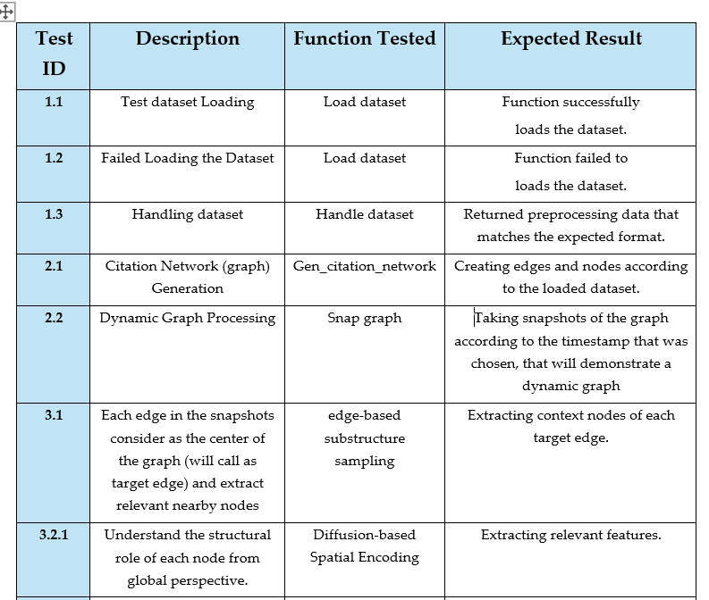
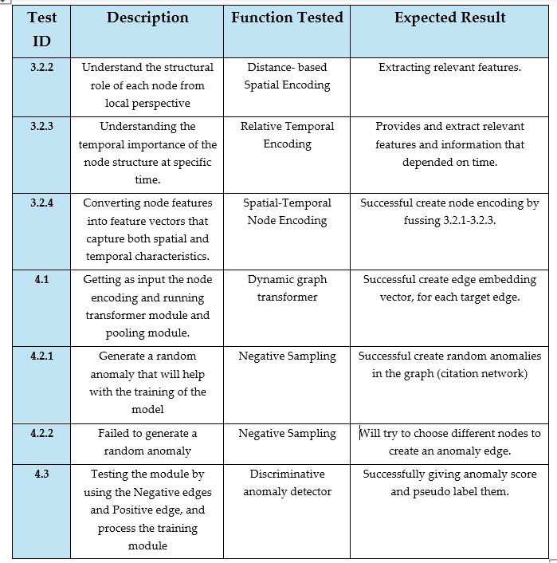
Testing plan

Slide 14
Expected achievements
Accurate Anomaly Detection: Identify unusual citation patterns indicative of potential misconduct or errors.
Improved Research Integrity: Contribute to a more reliable and trustworthy academic ecosystem.
Support for Research Evaluation: Provide data-driven evidence for evaluating research impact.
Track Research and Articles: Enable the ability to monitor research evolution and article trajectories over time.

Slide 15

Thank you!

